Slide 1
Data Mining
Association Analysis: Basic Concepts and Algorithms
Lecture Notes for Chapter 6
Introduction to Data Mining
by
Tan, Steinbach, Kumar
© Tan,Steinbach, Kumar Introduction to Data Mining 4/18/2004 <number>

Slide 2

Association Rule Mining
Many business enterprises accumulate large quantities of data from their daily operations
The table below illustrates an example of such data, commonly known as market-basket transactions
Each row in the table corresponds to a transaction, which contains a unique identifier TID and a set of items bought by a given customer
Focus of this chapter is association rule mining, which is useful for discovering interesting relationships hidden in large datasets
Market-Basket transactions
Example of Association Rules
{Diaper} → {Beer},
{Milk, Bread} → {Eggs,Coke},
{Beer, Bread} → {Milk}
Antecedent -> Consequent
Retailers can use this type of rules to identify new opportunities for cross-selling their products to customers

Slide 3

Definition: Frequent Itemset
Itemset
  A collection of one or more items
    Example: {Milk, Bread, Diaper}
  k-itemset
    An itemset that contains k items
    {Beer, Diapers, Milk} is an example of 3-itemset
Support count (σ)
  Frequency of occurrence of an itemset
  E.g. σ({Milk, Bread,Diaper}) = 2
Support
  Fraction of transactions that contain an itemset
  E.g. s({Milk, Bread, Diaper}) = 2/5
Frequent Itemset
  An itemset whose support is greater than or equal to a minsup threshold

Slide 4




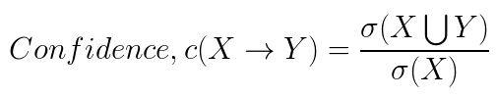
Definition: Association Rule
Association Rule
  An implication expression of the form X → Y, where X and Y are itemsets
  Example:
  {Milk, Diaper} → {Beer}
Rule Evaluation Metrics
  Support (s)
    Fraction of transactions that contain both X and Y
  Confidence (c)
    Measures how often items in Y
    appear in transactions that
    contain X
Example:

Slide 5
Association Rule Mining Task
Why Use Confidence and Support?
Support is an important measure because a rule that has very low support may occur simply by chance. A low support rule is also likely to be uninteresting from a business perspective because it may not be profitable to promote items that customers seldom buy together. For these reasons, support is often used eliminate uninteresting rules.
Confidence, on the other hand, measures the reliability of the inference made by a rule. For a given rule X -> Y, the higher the confidence, the more likely it is for Y to be present in transactions that contain X. Confidence also provides an estimate of the conditional probability of Y given X.

Slide 6
Association Rule Mining Task
Given a set of transactions T, the goal of association rule mining is to find all rules having
  support ≥ minsup threshold and
  confidence ≥ minconf threshold
Brute-force approach:
  List all possible association rules
  Compute the support and confidence for each rule
  Prune rules that fail the minsup and minconf thresholds
  ⇒ Computationally prohibitive!

Slide 7


Association Rule Mining Task
The total number of rules that can be extracted from a dataset that contains d items is
Even for small datasets, as shown in the table (d = 6), this approach requires us to compute the support and confidence of
rules. More than 80% of the rules are discarded after applying minsup = 20% and minconf = 50%. Most of the computations will thus be wasted
To avoid performing needless computations, it would be useful to prune the rules early without having to compute their support and confidence values

Slide 8
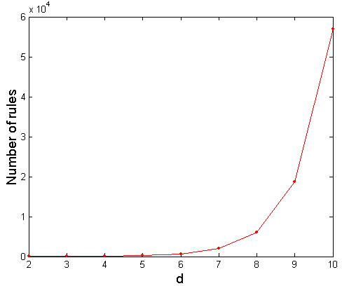
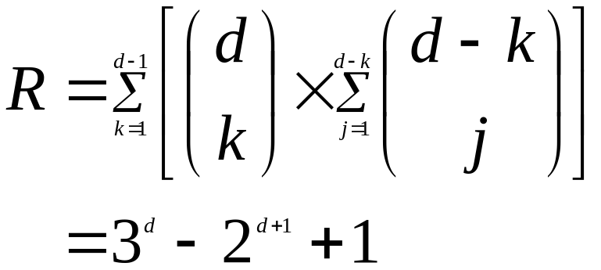
Computational Complexity
Given d unique items:
  Total number of itemsets = 2^{d}
  Total number of possible association rules:
If d=6, R = 602 rules

Slide 9
Mining Association Rules
Example of Rules:
{Milk,Diaper} → {Beer} (s=0.4, c=0.67)
{Milk,Beer} → {Diaper} (s=0.4, c=1.0)
{Diaper,Beer} → {Milk} (s=0.4, c=0.67)
{Beer} → {Milk,Diaper} (s=0.4, c=0.67)
{Diaper} → {Milk,Beer} (s=0.4, c=0.5)
{Milk} → {Diaper,Beer} (s=0.4, c=0.5)
Observations:
All the above rules are binary partitions of the same itemset:
{Milk, Diaper, Beer}
Rules originating from the same itemset have identical support but
can have different confidence
Thus, we may decouple the support and confidence requirements

Slide 10
Mining Association Rules
A common strategy adopted by many association rule mining algorithms is to decompose the problem into two major subtasks
  Frequent Itemset Generation
    Generate all itemsets whose support ≥ minsup. These itemsets are called frequent itemsets
  Rule Generation
    Generate high confidence rules from each frequent itemset, where each rule is a binary partitioning of a frequent itemset. These rules are called strong rules
Frequent itemset generation is still computationally expensive

Slide 11

Frequent Itemset Generation
Given d items, there are 2^{d} possible candidate itemsets (including the null set)

Slide 12

Frequent Itemset Generation
Brute-force approach:
  Each itemset in the lattice is a candidate frequent itemset
  Count the support of each candidate by scanning the database
  Match each transaction against every candidate
  Complexity ~ O(NMw) => Expensive since M = 2^{d} !!!
Maximum transaction width

Slide 13
Frequent Itemset Generation Strategies
There are several ways to reduce the computational complexity of frequent itemset generation:
Reduce the number of candidate itemsets: The Apriori principle is an effective way to eliminate some of the candidate itemsets without counting their support values
Reduce the number of comparisons: Instead of matching each candidate itemset against every transaction, we can reduce the number of comparisons by using more advanced data structures either to store the candidate itemsets or to compress the dataset

Slide 14
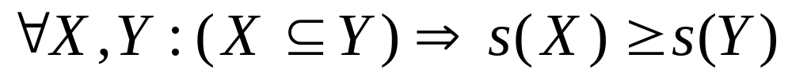
Reducing Number of Candidates
Apriori principle:
  If an itemset is frequent, then all of its subsets must also be frequent
Apriori principle holds due to the following property of the support measure:
  Support of an itemset never exceeds the support of its subsets
  This is known as the anti-monotone property of support

Slide 15
Illustrating Apriori Principle
To illustrate the idea behind the Apriori principle, consider the itemset lattice shown previously. Suppose {c,d,e} is a frequent itemset. Clearly, any transaction that contains {c,d,e} must also contain its subsets {c,d}, {c,e}, {d,e}, {c}, {d} and {e}. As a result, if {c,d,e} is frequent, then all subsets of {c,d,e} must also be frequent.
Conversely, if an itemset {a,b} is infrequent, then all of its supersets must be infrequent too. If an itemset {a,b} is found to be infrequent, then the entire subgraph containing the supersets of {a,b} can be pruned immediately. This strategy of trimming the exponential search space based on the support measure is called support-based pruning.

Slide 16
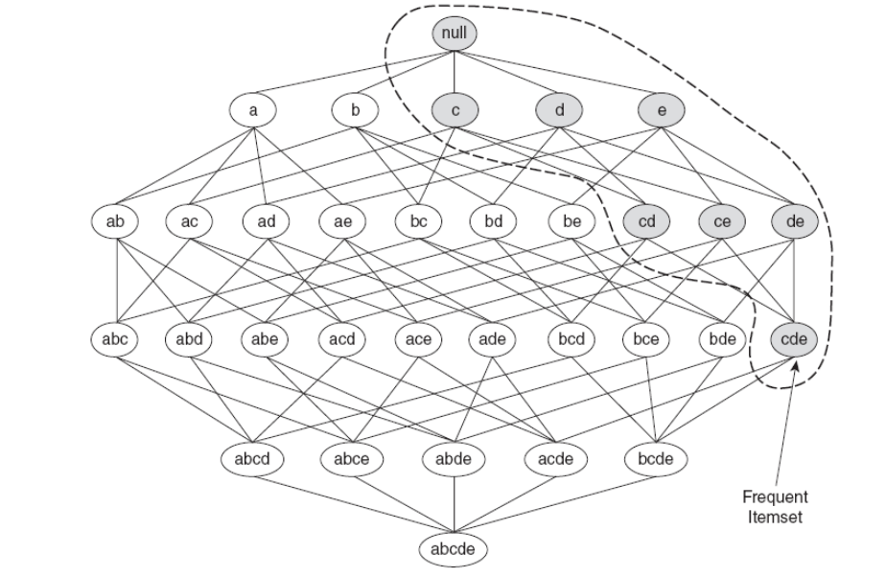
Illustrating Apriori Principle

Slide 17


Illustrating Apriori Principle
Found to be Infrequent
Pruned supersets

Slide 18

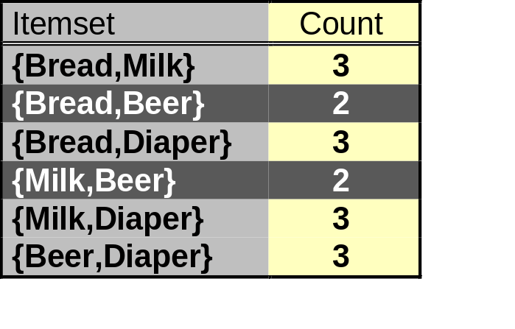
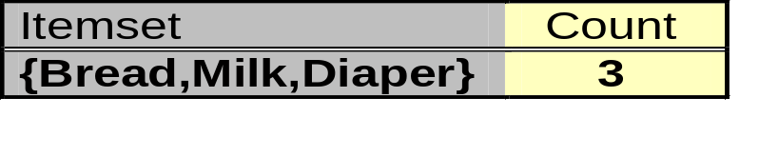
Illustrating Apriori Principle
Items (1-itemsets)
Pairs (2-itemsets)
(No need to generate
candidates involving Coke
or Eggs as they appear in
fewer than 3 transactions)
Minimum Support = 3
Triplets (3-itemsets)
If every subset is considered,
⁶C₁ + ⁶C₂ + ⁶C₃ = 41
With support-based pruning,
6 + 6 + 1 = 13
As per the Apriori principle, we only need to keep candidate 3-itemsets whose subsets are frequent. The only candidate that has this property is {Bread, Milk, Diapers}

Slide 19
Apriori Algorithm
Method:
  Let k=1
  Generate frequent itemsets of length 1
  Repeat until no new frequent itemsets are identified
    Generate length (k+1) candidate itemsets from length k frequent itemsets
    Count the support of each candidate by scanning the DB
    Eliminate candidates that are infrequent, leaving only those that are frequent

Slide 20
Apriori Algorithm
The algorithm initially makes a single pass over the data to determine the support of each item. Upon completion of this step, the set of all frequent 1-itemsets will be known.
Next, the algorithm iteratively generates new candidate k-itemsets using the frequent (k-1)-itemsets found in the previous iteration
To count the support of the candidates, the algorithm needs to make an additional pass over the dataset.
After counting their supports, the algorithm eliminates all candidate itemsets whose support counts are less than minsup
The algorithm terminates when there are no new frequent itemsets generated
The frequent itemset generation part of the Apriori algorithm has two important features. First, it is a level-wise algorithm, that is, it traverses the itemset lattice one level at a time, from frequent 1-itemsets to the maximum size of the frequent itemsets. Second, it employs a generate and test strategy for finding frequent itemsets. At each iteration, new candidate itemsets are generated from the frequent itemsets found in the previous iteration. The support for each candidate is then counted and tested against the minsup threshold. Candidates that do not meet this threshold are eliminated.

Slide 21

Apriori Algorithm
Candidate Generation and Pruning
The Apriori algorithm generates candidate itemsets by performing the following two operations:
Candidate Generation: This operation generates new candidate k-itemsets based on the frequent (k-1)-itemsets found in the previous iteration
Candidate Pruning: This operation eliminates some of the candidate k-itemsets using the support-based pruning strategy
In principle, there are many ways to generate the candidate itemsets. The following is a list of requirements for an effective candidate generation procedure:
It should avoid generating too many unnecessary candidates. A candidate itemset is unnecessary if at least one of its subsets is infrequent. Such a candidate is guaranteed to be infrequent according to the anti-monotone property of support.
It must ensure that the candidate set is complete, that is, no frequent itemsets are left out by the candidate generation procedure. To ensure completeness, the set of candidate itemsets must subsume the set of all frequent itemsets, that is,
3. It should not generate the same candidate itemset more than once. For instance, the candidate itemset {a,b,c,d} can be generated in many ways – by merging {a,b,c} with {d}, {b,d} with {a,c}, {c} with {a,b,d} etc. Generation of duplicate candidates leads to wasted computations and thus should be avoided for efficiency reasons.

Slide 22
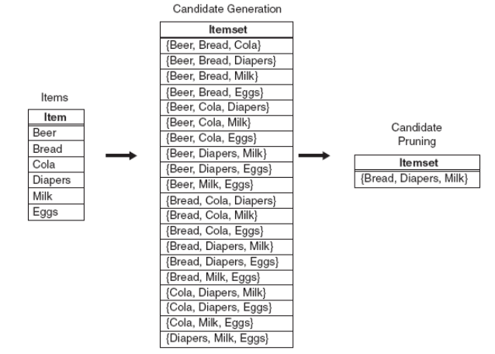
Apriori Algorithm
Candidate Generation Procedures
1. Brute-Force Method: The brute-force method considers every k-itemset as a potential candidate and then applies the candidate pruning step to remove any unnecessary candidates. The number of candidate itemsets at level k is equal to ^{d}C_{k} where d is the total number of items. Although candidate generation is rather trivial, candidate pruning becomes extremely expensive because a large number of itemsets must be examined.

Slide 23
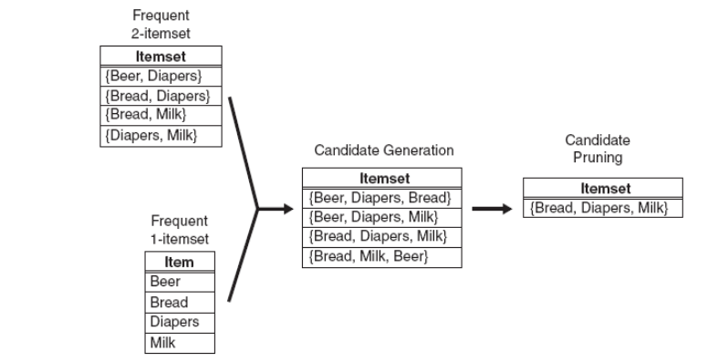
Apriori Algorithm
2. F_{k-1} x F₁ method: An alternative method for candidate generation is to extend each frequent (k-1) itemset with other frequent items. The figure illustrates how a frequent 2-itemset such as {Beer, Diapers} can be augmented with a frequent itemset such as Bread to produce a candidate 3-itemset {Beer, Diapers, Bread}.

Slide 24
Apriori Algorithm
This procedure is complete because every frequent k-itemset is composed of a frequent (k-1)-itemset and a frequent 1-itemset. Therefore, all frequent k-itemsets are part of the candidate k-itemsets generated by this procedure.
However, this approach may generate the same candidate itemset more than once. For instance, {Bread, Diapers, Milk} can be generated by merging {Bread, Diapers} with {Milk}, {Bread, Milk} with {Diapers} or {Diapers, Milk} with {Bread}.
One way to avoid generating duplicate candidates is by ensuring that the items in each frequent itemset are kept sorted in their lexicographic order. Each frequent (k-1)-itemset X is then extended with frequent items that are lexicographically larger than the items in X. For example, the itemset {Bread, Diapers} can be augmented with {Milk} since Milk is lexicographically larger than Bread and Diapers. However, we should not augment {Diapers, Milk} with {Bread} nor {Bread, Milk} with {Diapers} because they violate the lexicographic ordering condition.
While this procedure is a substantial improvement over the brute force approach, it can still produce a large number of unnecessary candidates. For example, the candidate itemset produced by merging {Beer, Diapers} with {Milk} is unnecessary because one of its subsets {Beer, Milk} is infrequent.

Slide 25
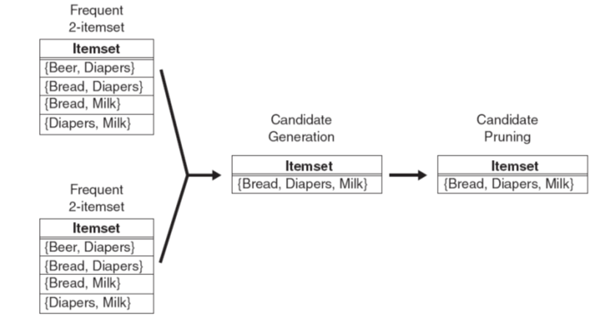
Apriori Algorithm
3. F_{k-1} x F_{k-1} method: This method merges a pair of frequent (k-1)-itemsets only if their first k-2 items are identical. Let A = {a₁, a₂, … a_{k-1}} and B = {b₁, b₂, … b_{k-1}} be a pair of frequent (k-1)-itemsets. A and B are merged if they satisfy the following condition:

Slide 26
Apriori Algorithm
In the figure, the frequent items {Bread, Diapers} and {Bread, Milk} are merged to form a candidate 3-itemset {Bread, Diapers, Milk}.
The algorithm does not have to merge {Beer, Diapers} with {Diapers, Milk} because the first item in both itemsets is different.
Indeed, if {Beer, Diapers, Milk} is a viable candidate, it would have been obtained by merging {Beer, Diapers} with {Beer, Milk} instead.
This example illustrates both the completeness of the candidate generation procedure and the advantages of using lexicographic ordering to prevent duplicate candidates.
However, because each candidate is obtained by merging a pair of frequent (k-1)-itemsets, an additional candidate pruning step is needed to ensure that the remaining k-2 subsets of the candidate are frequent.

Slide 27
Factors Affecting Complexity
Choice of minimum support threshold
  lowering support threshold results in more frequent itemsets
  this may increase number of candidates and max length of frequent itemsets
Dimensionality (number of items) of the data set
  more space is needed to store support count of each item
  if number of frequent items also increases, both computation and I/O costs may also increase
Size of database
  since Apriori makes multiple passes, run time of algorithm may increase with number of transactions
Average transaction width
  transaction width increases with denser data sets
  This may increase max length of frequent itemsets (number of subsets in a transaction increases with its width)

Slide 28
Apriori Algorithm
Rule Generation
Each frequent k-itemset can produce up to 2^{k} – 2 association rules, ignoring the rules that have empty antecedents or consequents (Ø -> Y or Y ->Ø)
An association rule can be extracted by partitioning the itemset Y into two non-empty subsets X and Y – X, such that X -> Y – X satisfies the confidence threshold
Note that all such rules must have already met the support threshold because they are generated from a frequent itemset
Example
Let X = {1,2,3} be a frequent itemset. There are 6 candidate association rules that can be generated from X: {1,2} -> {3}, {1,3} -> {2}, {2,3} -> {1}, {1} -> {2,3}, {2} -> {1,3} and {3} -> {1,2}. As each of their support is identical to the support of X, the rules must satisfy the support threshold.
Computing the confidence of an association rule does not require additional scan of the transaction dataset. Consider the rule {1,2} -> {3}, which is generated from the frequent itemset X = {1,2,3}. The confidence for this rule is σ{1,2,3} / σ{1,2}. Because {1,2,3} is frequent, the anti-monotone property of support ensures that {1,2} must be frequent too. Since the support counts for both itemsets were already found during frequent itemset generation, there is no need to read the entire dataset again.

Slide 29
Apriori Algorithm
Confidence-based Pruning
Unlike the support measure, confidence does not have any monotone property. However, the following theorem holds for the confidence measure:
Theorem
If a rule X -> Y – X does not satisfy the confidence threshold, then any rule, X’ -> Y – X’, where X’ is a subset of X must not satisfy the confidence threshold as well.
Proof: Consider the following two rules: X’ -> Y – X’ and X -> Y – X, where X’ is a subset of X. The confidence of the rules are σ(Y) / σ(X’) and σ(Y) / σ(X) respectively. Since, X’ is a subset of X, σ(X’) >= σ(X). Therefore, the former rule cannot have a higher confidence than the latter rule.

Slide 30
Apriori Algorithm
Rule Generation in the Apriori Algorithm
The Apriori algorithm uses a level-wise approach for generating association rules, where each level corresponds to the number of items that belong to the rule consequent.
Initially, all the high confidence rules that have only one item in the rule consequent are extracted.
These rules are then used to generate new candidate rules
For example, if {a,c,d} -> {b} and {a,b,d} -> {c} are high confidence rules, then the candidate rule {a,d} -> {b,c} is generated by merging the consequents of both the rules.
The figure in the next slide shows the lattice structure for the association rules generated from the frequent itemset {a,b,c,d}. If any node in the lattice has low confidence, then according to the theorem, the entire sub-graph spanned by the node can be pruned immediately.

Slide 31
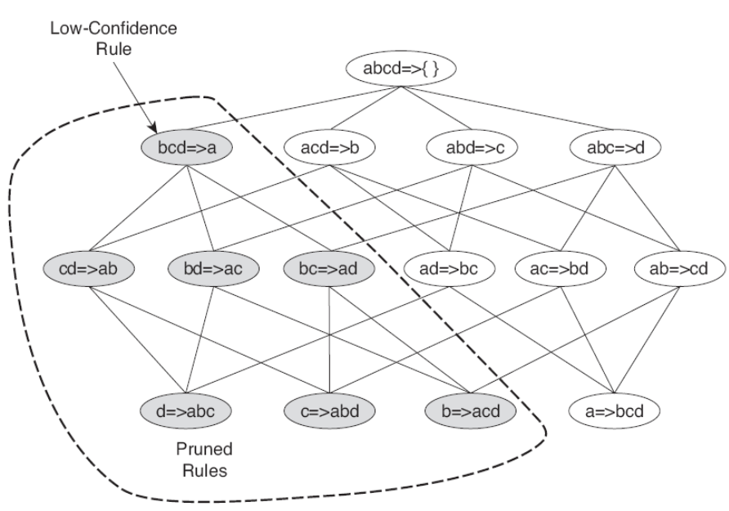
Apriori Algorithm

